Slide 1
Data Analysis for Education Consultants
Qaif Fangari May 26th, 2020

Slide 2
Background
Education consultancy is one of the major industry which has been in operation for a quite a some time now, generally their success is measured based on the parameter that how well the student manage to earn after following their advice on the choice of college and the course.

Slide 3
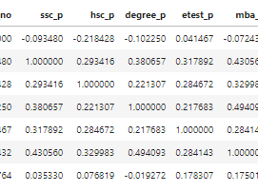
Exploratory Data Analysis
Correlation between non categorical factors

Slide 4
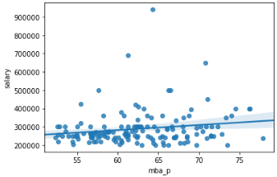
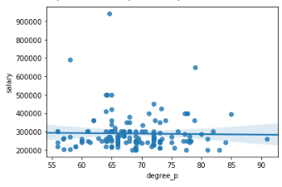
Correlation between Different factors and salary

Slide 5
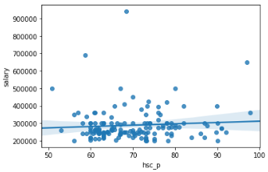
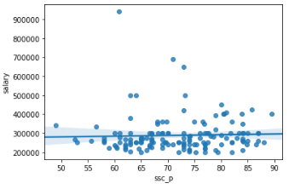
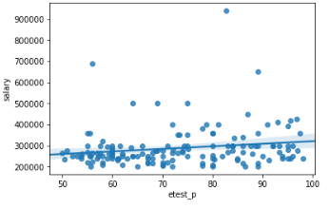
Correlation between Different factors and salary

Slide 6
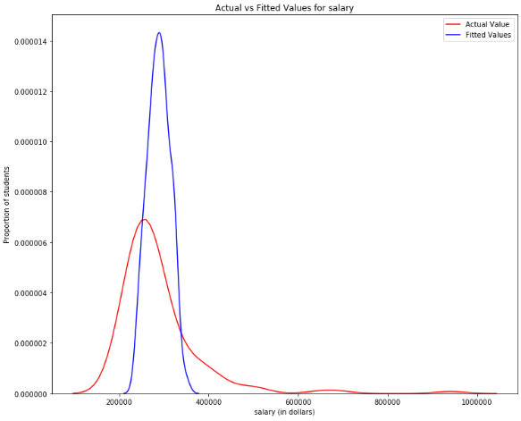
MODEL FIT

Slide 7
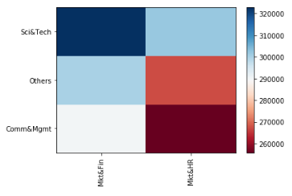
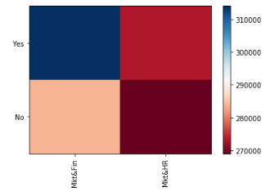
Categorical factors

Slide 8

THANK YOU

